Slide 1



MSC. RESEARCH PROJECT, CENTRE OF excellence FOR Data science, artificial intelligence & modelling (DAIM) university of hull, uk

Slide 2

Agenda
Introduction
About the Data
Live Demo
Results
Discussion
Limitations
Methodology
Future Work
Summary

Slide 3

Current Information Retrieval Challenges
INTRODUCTION
UK Building Regulations are legally enforced technical standards that govern the design, construction, and alteration of buildings.
UK Building Regulations are complex, updated frequently, and exist in static PDFs
Inspectors, Contractors, surveyors, and planners face difficulties in accessing regulatory answers.
Need for an AI solution that makes these regulations searchable, understandable, and accurate.
Notes:
UK Building Regulations are legally enforced technical standards that govern the design, construction, and alteration of buildings. They cover areas such as fire safety, structural integrity, energy efficiency, and accessibility. These regulations are complex, updated frequently, and exist in static PDFs
in England and Wales. They cover areas such as fire safety, structural integrity, energy efficiency, and accessibility.

Slide 4

RESEARCH QUESTION AND MOTIVATION
This research investigates how different LLM architectures perform in retrieving UK Building Regulations, focusing on trade-offs between model size, domain specialization through fine-tuning, and deployment architecture.
It is motivated by limited AI use in navigating complex and frequently updated regulations, and the need for faster, safer access to critical building information through intelligent retrieval.

Slide 5
RESEARCH AIM & OBJECTIVES
The primary aim of this research is to enhance a chatbot that provides guidance on UK Building Regulations through the integration of RAG and LLMs. Specific objectives include:
🔴 Expanding the chatbot's knowledge base using PDFs from GOV.UK.
🔴 Implementing RAG to improve response accuracy in chatbot interactions.
🔴 Fine-tuning LLMs with domain-specific data to enhance their contextual understanding and response generation.

Slide 6
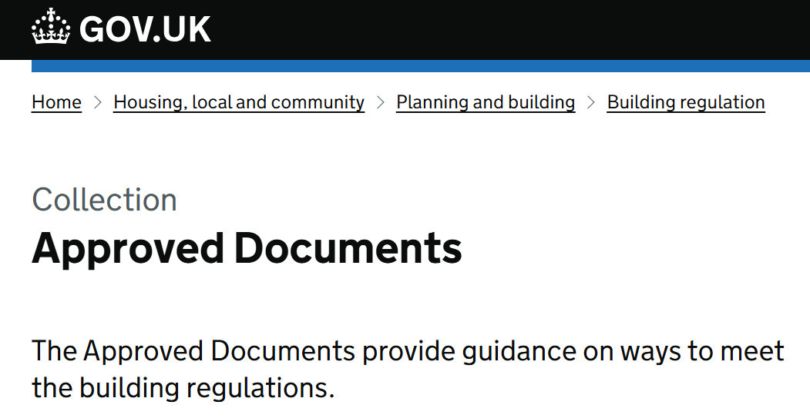
About the Data (Unstructured for RAG & Structured for LoRA Tuning)
Preprocessing
18 PDFs [Parts A-S]
10 FAQ PDFs
Curated 3000 Instruction-Pair QA
Source: https://www.gov.uk/government/collections/approved-documents
Notes:
Prompting, Vector store using Unstuctured Data but fine-tuning process used structured data
I deliberately chose GOV.UK building regulations as my knowledge base because they represent the authoritative, well-structured regulatory documents with guaranteed accuracy. This choice minimizes the risk of false information while providing a consistent document structure that benefits the RAG pipeline's retrieval mechanisms. The official nature of these documents ensures that StructureGPT provides guidance based on legally binding requirements rather than interpretations or opinions.
3K QA PAIARS, (~3K Q&A pairs) is not large enough to make fine tuning self-sufficient, so the fine tuned model still needs context.
LoRA tuning insufficient without structured instruction data
LLMs required minimal cleaning compared to traditional ML workflows:
Trained on noisy internet data, so naturally robust to inconsistency
Infer meaning through context and manage unstructured input well
Self-supervised pretraining gives them strong generalization skills
While traditional ML would require heavy cleaning, normalization, and feature engineering, LLMs can often be deployed with only structural preparation (e.g., chunking, formatting)
When working with Large Language Models (LLMs), less data cleaning is often required compared to traditional machine learning approaches for several key reasons:
Robust to noise and inconsistencies - LLMs are trained on vast amounts of messy internet text, making them naturally tolerant of variations, typos, and inconsistent formatting.
Contextual understanding - LLMs can infer meaning from context, allowing them to work around missing values, unusual phrasing, or inconsistent terminology.
Natural language processing capabilities - They excel at handling unstructured text data in its natural form without requiring extensive preprocessing.
Strong generalization - The scale of pretraining helps LLMs develop powerful generalization abilities that work across diverse data formats.
Self-supervision - LLMs learn patterns from the data itself rather than requiring explicit feature engineering or normalization.
This doesn't mean data cleaning is completely unnecessary - for specialized applications or when working with highly technical data, some preprocessing may still improve performance. However, LLMs generally require much less upfront data cleaning compared to traditional ML methods that often demand extensive normalization, imputation, and feature engineering.

Slide 7

METHODOLOGY
Notes:
DATA
--DATA ACQUISITION GOV.UK [18PDF] UNSTRUCTURED
--DATA CURATIONS FAQ [10PDFS]AND GOV.UK DATA [3000 INSTRUCTUTION-QA-PAIR [STRUCTURED]
VECTOR STORE[CHROMA-DB] [ TOKEN EMBEDDINGS ]
RAG RETRIVAL
--LLMS USED
---LLama3.3-70B
---Llama3.1-8B
---Llama3.1-8B-Instruct
FINE TUNING
Low Rank Adaptation [Enhancing Training process while fine tuning ] – Frozen weights
Quantization [Model Size Reduction] From base 32bit (4bytes) to 8bit(1byte) quantization
RAG EVALUATION
RAGAS & GISKARD
Deployment to HF

Slide 8
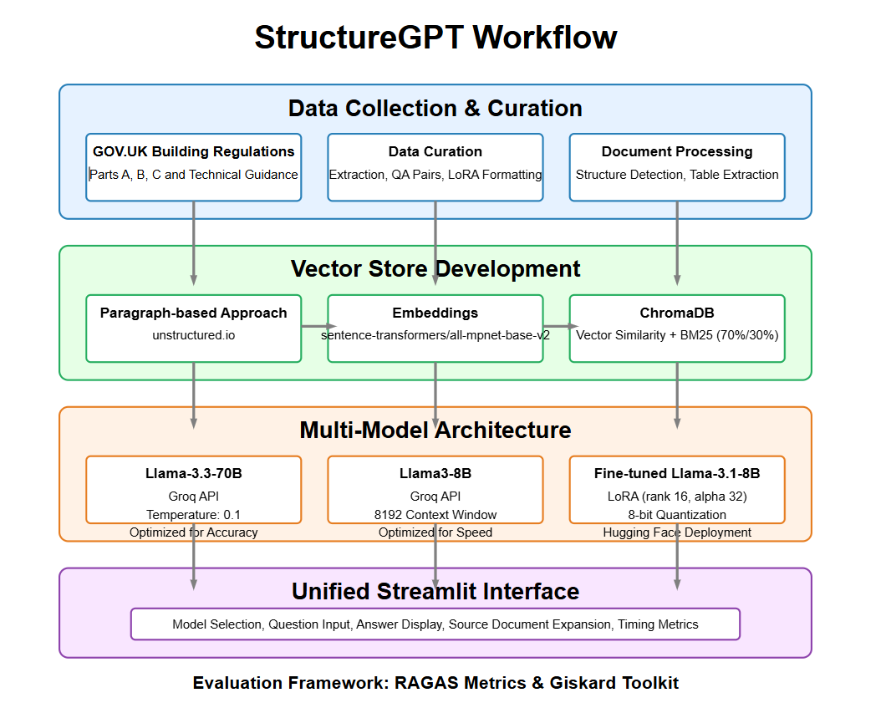
Tools
Unstructured API
ChromaDB
Groq API
Streamlit
Hugging Face

Slide 9
Key Terms: RAG, Low Rank Adaptation & Quantization
Retrieval-Augmented Generation (RAG)
Low-Rank Adaptation (LoRA)
A lightweight fine-tuning method that adds small trainable layers to large models, making them domain-specific with less compute and storage.
Quantization
Reduces model size and speeds up inference by lowering weight precision (e.g., 32-bit → 8-bit), enabling deployment on resource-limited systems.
Enhances LLM outputs by retrieving relevant text (e.g., UK Building Regulations) before generating a response, improving accuracy and grounding.
Notes:
Fine-tuning gives the model better familiarity with domain language, format, and tone — but it does not eliminate the need for retrieval, because:
The model doesn’t memorize all building regulations.
Regulations change — so dynamic context from ChromaDB ensures updated and localized answers
Key: Although the fine-tuned model was trained on UK Building Regulation Q&A pairs, it still uses the RAG framework and therefore relies on retrieved context from ChromaDB. This helps ensure responses are grounded in the most relevant document passages and not just generated from memory
Retrieval-Augmented Generation (RAG): A technique that enhances language model outputs by first retrieving relevant information from a knowledge base, then using that information to generate more accurate and contextually appropriate responses. In your case, the knowledge base would contain UK building regulations.
Low-Rank Adaptation (LoRA): A parameter-efficient fine-tuning technique that adds trainable low-rank matrices to frozen pre-trained model weights. This allows you to adapt a large language model to your specific domain (building regulations) with significantly fewer trainable parameters, reduced computational resources, and less risk of catastrophic forgetting.
Quantization: A technique that reduces the precision of the numerical values used to represent model weights (e.g., from 32-bit floating point to 8-bit integers). This significantly reduces model size and inference time while maintaining acceptable performance. In your project, quantization likely helps make the system more deployable in real-world engineering environments with limited computational resources.

Slide 10
Large Language Models utilized in RAG System
Llama 3.3-70B
Superior reasoning capabilities
Higher accuracy
Llama 3.1-8B
Speed advantage
Cost effectiveness
Fine-tuned
Llama 3.1-8B-Instruct
Domain Specialization
Follows instructions better
Notes:
✅ LLaMA 3.3-70B (Groq-hosted)
🔹 1. Superior reasoning capabilities
Enables deeper understanding of complex and conditional regulatory logic — vital for interpreting building codes correctly.
🔹 2. Higher accuracy
Produces the most reliable answers in safety-critical contexts like fire resistance or structural compliance.
📌 Justification: You need maximum reliability for legally binding advice, especially in areas where misunderstanding a clause can lead to construction risk.
✅ LLaMA 3.1-8B (Groq-hosted)
🔹 1. Speed advantage
Delivers near-instant responses — ideal for real-time use in design or planning environments.
🔹 2. Cost effectiveness
Enables scalable deployment in public portals or SME environments without the heavy inference cost of 70B.
📌 Justification: It’s your ideal model for low-latency regulatory chatbots that remain grounded in accuracy but are cheap and scalable.
✅ Fine-tuned LLaMA 3.1-8B-Instruct (Hugging Face + LoRA)
🔹 1. Domain specialization (via LoRA)
Tailored to understand UK Building Regs language and logic — crucial for producing answers in the right tone and scope.
🔹 2. Follows instructions better
More reliable at responding to regulation-specific prompts and formatting answers clearly (e.g., “Refer to Part B, Section 6.3”).
📌 Justification: Fine-tuning on Q&A pairs makes it the best candidate for structured, regulation-aware outputs — even if it underperforms on raw accuracy.

Slide 11
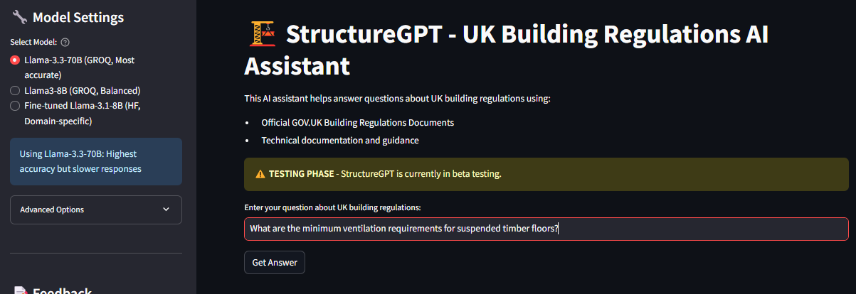
🔴 LIVE DEMO
https://huggingface.co/spaces/SamuelJaja/uk-building-regulations-bot

Slide 12

Notes:
Dual Evaluation for Robustness and Responsible AI in sight with Frameworks( RAGAS & Giskard)
RAGAS focuses on granular performance metrics, providing quantitative evaluation of RAG system capabilities through context recall, answer relevancy, and faithfulness. Giskard, conversely, concentrates on vulnerability detection, conducting a modular architectural analysis to identify potential risks like hallucinations, biases, and system robustness.
By integrating both frameworks, I developed a comprehensive approach that assesses both the technical performance and safety of the StructureGPT system, which is critical when applying AI to high-stakes domains like building regulations.

Slide 13
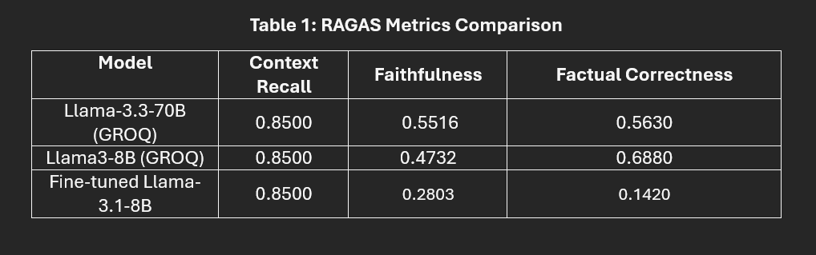
RAGAS Evaluation
Notes:
Context Recall: Measure how well the system retrieves the correct information from documents.
Faithfulness: Measures whether the generated answer sticks to the retrieved content.
Factual Correctness: Whether the answer is factually correct based on a reference answer.
Highlight: 3-8B had best factual correctness and best overall correctness , 70B best faithfulness, fine-tuned model underperformed

Slide 14
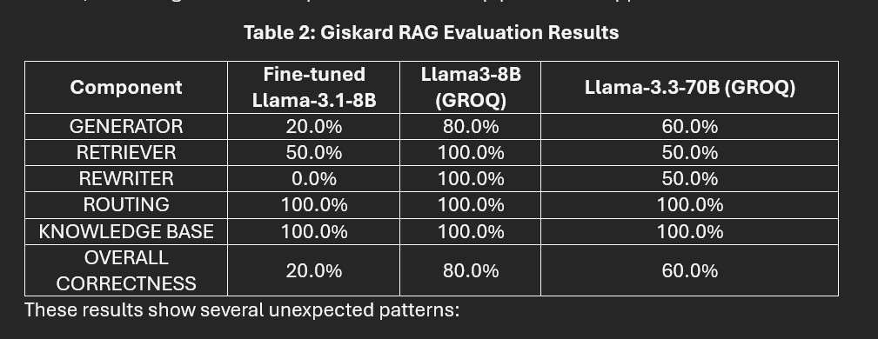
Giskard Evaluation
Notes:
Highlight: 3-8B had best factual correctness and best overall correctness , 70B best faithfulness, fine-tuned model underperformed

Slide 15
Discussion
Hybrid retrieval’s consistency across models confirms its strength and potential in other regulatory fields like healthcare or finance.
The fine-tuned model’s results indicate that standard LoRA may be insufficient for technical domains. Multi-stage tuning may be needed for formatting, citations, and specification handling.
8B model's performance suggests that smaller models on optimized infrastructure can outperform larger or fine-tuned ones for regulatory tasks.
Notes:
Practically, the Llama3-8B model's performance suggests that smaller models on optimized infrastructure can outperform larger or fine-tuned ones for regulatory tasks.
The fine-tuned model’s results indicate that standard LoRA may be insufficient for technical domains. Multi-stage tuning may be needed for formatting, citations, and specification handling.
Hybrid retrieval’s consistency across models confirms its strength and potential in other regulatory fields like healthcare or finance.

Slide 16
Limitations
No multimodal input (diagrams) based on user study
Limited fine-tuning dataset (~3K QA Pairs)
Domain Knowledge in Building Construction
Time Factor
Notes:
Why did the fine-tuned model underperform compared to the base LLaMA-3-8B?
Because the fine-tuned model was trained on only ~3,000 instruction-style Q&A pairs, which lacked structural variety and scale. While it learned formatting and tone, it didn't gain enough factual grounding to outperform the general-purpose 8B model. This highlights that fine-tuning without robust data can limit factual correctness.

Slide 17

Future Works
Implications, Commercialization & Future Work
Add multimodal capabilities (images/diagrams)
Better Multi-stage fine-tuning with instruction-tuned Q&A pairs
Considering that perfection is a myth in research, I consider publishing my work.
Government: Chatbot integration to support planners & surveyors.
RegTech: SaaS product for regulation compliance (subscription model)
Innovation: Can be positioned for UKRI Smart Grant as an AI-for-Governance tool
Notes:
Adjusting lora parameters (rank and alpha)
Future work should follow Jeong’s (2024) strategy: growing the dataset, refining prompts, and using multi-stage instruction tuning to improve results across more building regulation sections.
Key future directions include:
Multi-stage Retrieval – Use different retrievers for text, specs, and diagrams to improve relevance.
Hybrid Model Systems – Route questions to different models based on content type.
Better Fine-Tuning – Try instruction-tuning and structure-aware architectures.
Self-Verification – Let models check their answers, especially for numbers and citations.
Workflow Integration – Build tools that plug directly into construction and compliance tasks, including agentic reasoning and multi-modal integration.

Slide 18
Summary
I achieved all objectives: multi-model RAG, model comparison, and domain-specific deployment.
LLaMA 3.1-8B delivered best overall performance (80% pipeline correctness)
Hybrid retrieval maintained high context recall (0.85) across models.
StructureGPT offers a practical, scalable approach to make complex UK Building Regulations more accessible, transparent, and usable by professionals.
Notes:
Beyond technical achievements, this project established a practical framework for making complex regulatory information more accessible to construction professionals.
Conclusion
This project successfully achieved all objectives: implementing a multi-model RAG system, comparing LLaMA-based architectures, and deploying a fine-tuned domain-specific model.
The evaluation revealed trade-offs between model scale, specialization, and deployment speed, with the LLaMA-3.1-8B model outperforming both 70B and fine-tuned models in pipeline correctness (80% vs 60% and 20%).
The hybrid retriever maintained high context recall (0.85) across all models, validating the architecture's grounding strength.
StructureGPT offers a practical, scalable approach to make complex UK Building Regulations more accessible, transparent, and usable by professionals.
Its modular design and Streamlit interface make it adaptable across sectors and suitable for commercial and governmental deployment.

Slide 19


